Slide 1

MINI PROJECT
ASHEEF BAIJU
ARUN KUMAR
CHETAN PRASAD
CHIRAG MISKIN

Slide 2
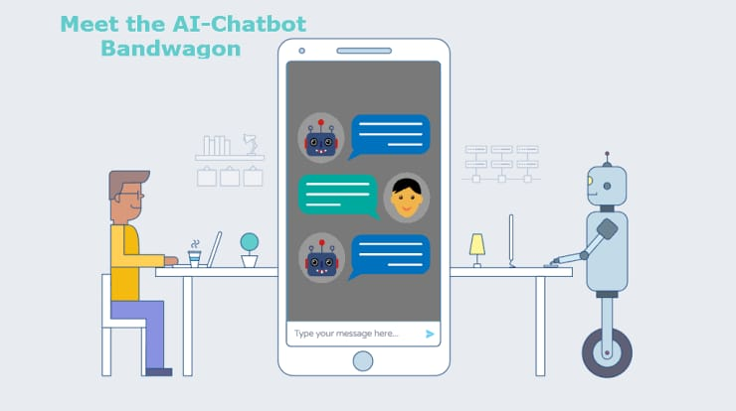
PROBLEM STATEMENT
To build an - AI CHATBOT FOR HEALTHCARE PURPOSE
A chatbot is a computer program that simulates human conversation through voice commands or text chats or both. Chatbot, short for chatterbot, is an Artificial Intelligence (AI) feature that can be embedded and used through any major messaging applications and was first built by Michael Mauludin.

Slide 3
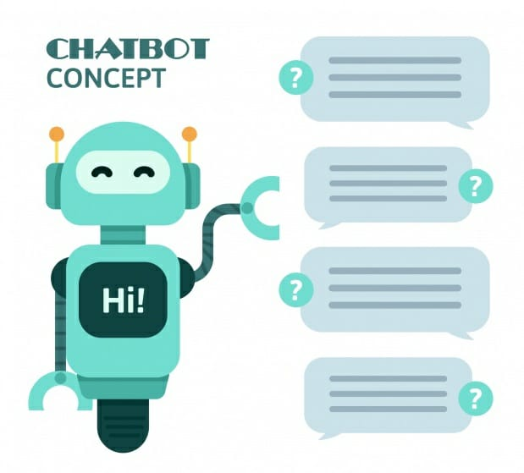
SCOPE
Accelerate the speed and reduce the hassle of travelling to clinics.
Accessible to people anywhere at any time.
Easy to use

Slide 4
TECHNOLOGY & TIMELINE
Python ( tkinter, matplotlib, pandas, sklearn)
Git (version control)
The chatbot will take approximately 24hr to code.

Slide 5
Advantages
1. Omni-capable
The chat bot converses seamlessly across multiple digital channels and retains data and context for a seamless experience. In best cases, even passing that information to a live agent if needed.
2. Free to Explore
The chat bot can reach, consume, and process vast amounts of data– both structured and unstructured–to surface insights from any source - to gather relevant data to solve customer issues quickly.
3. Autonomous Reasoning
The chat bot can perform complex reasoning without human intervention. For example, a great Service chatbot should be able to infer solutions based on relevant case histories.

Slide 6
4. Pre-Trained
The chat bot is pre-trained to understand brand-specific or industry-specific knowledge and terms. Even better, it’s pre-configured to resolve common customer requests of a particular industry.
5. Register/Log-in
To access this chat bot and individual needs to register and then use the registration ID to log in to access the features.
6. User Interface
A user friendly interface which is engaging and easy to access.

Slide 7
THANK YOU

